Slide 1

Unit – 4 Descriptive Statistics
MCA $→$2nd Semester
Mathematics for Computer Application (2305HS203)
Prof. Mehul Chaurasia
Department of Humanities & Science
mehul.chaurasia @darshan.ac.in
9879282804

Slide 2

Topics of Unit 1
Measure of Central Tendency
Measure of Dispersion
Measures of Association:
Covariance
Correlation Coefficient
Rank Correlation Coefficient
Linear Regression
Curve Fitting
Fitting of Trend by Moving Average Method.
Looping

Slide 3

Outline of Unit 1
Measure of Central Tendency
Mean
Median
Mode
Quartiles
Percentiles
Looping

Slide 4

Outline of Unit 1
Measures of Dispersion
Range
Interquartile Range
Standard Deviation
Variance
Coefficient of Variation
Mean Deviation
Looping

Slide 5

Looping
Outline of Unit 1
Measures of Association
Covariance
Correlation Coefficient
Rank Correlation Coefficient
Simple Linear Regression
Curve Fitting by Straight Line and Parabola (Least Square Method)
Fitting of Trend by Moving Average Method

Slide 6
Method 1 Measure of Central Tendency

Slide 7
Introduction
Statistics is the branch of science where we plan, gather and analyze information about a particular collection of objects under investigation.
Statistics techniques are used in every other field of science, engineering and humanity, ranging from computer science to industrial engineering to sociology and psychology.
For any statistical problem the initial information collection from the sample may look messy, and hence confusing. This initial information needs to be organized first before we make any sense out of it.

Slide 8
Central Tendency
The central tendency of a distribution is an estimate of the center of a distribution of values.
There are three measures to estimate central tendency which is
Mean$\left( \overline{x} \right)$
Median $\left( M \right)$
Mode $\left( Z \right)$
Quartiles $\left( Q_{1} \&{ Q}_{3}\right)$
Percentiles $\left( P_{k}\right)$

Slide 9
Method 1.1 Mean

Slide 10
Mean
The mean means average.
Mean is denoted by “ $\overline{x}$ ” and read as x bar.
Table of different formulae of mean.

Slide 11
Mean
Method | Ungrouped Data | Discrete Grouped Data | Continuous Grouped Data
Direct Method
Assumed Mean Method
Step Deviation Method
$$\frac{\sum{x_{i}}}{n}$$
$$\frac{\sum{f_{i}x_{i}}}{\sum{f_{i}}}$$
$$A+\frac{\sum{d_{i}}}{n}$$
$$A+\frac{\sum{f_{i}d_{i}}}{\sum{f_{i}}}$$
$$A+\frac{ \sum{f_{i}u_{i}}}{\sum{f_{i}}}×c$$
$$\text{−−−−−}$$
$$\text{−−−−−}$$

Slide 12
Mean
$n=$Total number of observations
$c=$Class Length
In case of continuous frequency distribution,
$x_{i}=$ mid value of the respective class.
In case of assumed mean method, $A$ can be any value from${ x}_{i}$.
Use following formula to calculate $d_{i} \& u_{i}$
$$u_{i}=\frac{x_{i}−A}{c}$$
$$d_{i}=x_{i}−A$$

Slide 13
Method 1.1 ⇝ Example 1
Find the mean of data $10.2, 9.5, 8.3, 9.7, 9.5, 11.1, 7.8, 8.8, 9.5, 10.$
Solution:
Here, total number of observations
$n=10$ are
Now,
$$\overline{x}=\frac{\sum{x_{i}} }{n }$$
$$\overline{x}=\frac{10.2+9.5+8.3+9.7+9.5+11.1+7.8+8.8+9.5+10}{10}$$
$$⇒$$
$$\overline{x}=\frac{94.4 }{10 }$$
$$⇒$$
$$⇒$$
$$\overline{x}=9.44$$

Slide 14
Method 1.1 ⇝ Example 2
Find the mean for following data:
Marks obtained
Number of students
$$20$$
$$9$$
$$25$$
$$50$$
$$40$$
$$80$$
$$6$$
$$4$$
$$16$$
$$7$$
$$8$$
$$2$$
Solution:
We will find the mean of the given data using the direct method.
So,
$$\overline{x}=\frac{\sum{f_{i}x_{i}} }{\sum{f_{i}}}$$

Slide 15
Method 1.1 ⇝ Example 2 (Continue)
$$x_{i}$$ | $$f_{i}$$ | $$f_{i} x_{i}$$
-----
$$\overline{x}=\frac{\sum{f_{i}x_{i}} }{\sum{f_{i}}}$$
$$20$$
$$6$$
$$20∙6=120$$
$$9$$
$$4$$
$$36$$
$$\overline{x}=\frac{1386 }{43 }$$
$$25$$
$$16$$
$$400$$
$$⇒$$
$$50$$
$$7$$
$$350$$
$$40$$
$$8$$
$$320$$
$$⇒$$
$$\overline{x}=32.23$$
$$80$$
$$2$$
$$160$$
$$\sum{f_{i}}$$
$$\sum{f_{i}}x_{i}$$
$$=43$$
$$=1386$$

Slide 16
Method 1.1 ⇝ Example 3
Find the mean using direct method, assumed mean method and step deviation method:
Marks obtained
Number of students
$$0−10$$
$$10−20$$
$$20−30$$
$$30−40$$
$$40−50$$
$$5$$
$$10$$
$$40$$
$$20$$
$$25$$
Solution:
Direct Method
Assumed mean method
Step Deviation Method
$$\overline{x}=\frac{\sum{f_{i}x_{i}} }{\sum{f_{i}}}$$
$$\overline{x}=A+\frac{ \sum{f_{i} d_{i} }}{\sum{f_{i}}}$$
$$\overline{x}=A+\frac{ \sum{f_{i} u_{i} }}{\sum{f_{i}}}×c$$

Slide 17
Method 1.1 ⇝ Example 3 (Continue)
Assumed mean method
Direct Method
$$\overline{x}=\frac{\sum{f_{i}x_{i}} }{\sum{f_{i}}}$$
Step Deviation Method
$$Class$$ | $$f_{i}$$ | $$x_{i}$$
$$f_{i}x_{i}$$
$$0−10$$
$$5$$
$$5$$
$$5∙5=25$$
$$10−20$$
$$10$$
$$15$$
$$150$$
$$\overline{x}=\frac{3000 }{100 }$$
$$⇒$$
$$20−30$$
$$40$$
$$25$$
$$1000$$
$$30−40$$
$$20$$
$$35$$
$$700$$
$$40−50$$
$$25$$
$$45$$
$$1125$$
$$⇒ \overline{x}=30$$
$$\sum{f_{i}}=100$$
$$\sum{f_{i}}x_{i}=3000$$
$$\overline{x}=A+\frac{ \sum{f_{i} d_{i} }}{\sum{f_{i}}}$$
$$\overline{x}=A+\frac{ \sum{f_{i} u_{i} }}{\sum{f_{i}}}×c$$

Slide 18
Method 1.1 ⇝ Example 3 (Continue)
Step Deviation Method
Assumed mean method
$$Class$$ | $$f_{i}$$ | $$x_{i}$$
$$d_{i}$$
$$f_{i}d_{i}$$
$$0−10$$
$$5$$
$$5$$
$$5−25=−20$$
$$5∙\left(−20\right)=−100$$
$$10−20$$
$$10$$
$$15$$
$$−10$$
$$−100$$
$$20−30$$
$$40$$
$$25$$
$$=A$$
$$0$$
$$0$$
$$30−40$$
$$20$$
$$35$$
$$10$$
$$200$$
$$40−50$$
$$25$$
$$45$$
$$20$$
$$500$$
$$\sum{f_{i}}=100$$
$$\sum{f_{i}d_{i}}=500$$
$$\overline{x}=A+\frac{ \sum{f_{i} d_{i} }}{\sum{f_{i}}}$$
$$\overline{x}=25+\frac{ 500}{100}$$
$$⇒$$
$$⇒$$
$$\overline{x}=30$$
$$\overline{x}=A+\frac{ \sum{f_{i} u_{i} }}{\sum{f_{i}}}×c$$

Slide 19
Method 1.1 ⇝ Example 3 (Continue)
Step Deviation Method
$$Class$$ | $$f_{i}$$ | $$x_{i}$$
$$u_{i}$$
$$f_{i}u_{i}$$
$$c=10$$
$$0−10$$
$$5$$
$$5$$
$$−2$$
$$−10$$
$$u_{1}=\frac{x_{1}−A}{c}$$
$$10−20$$
$$10$$
$$15$$
$$−1$$
$$−10$$
$$20−30$$
$$40$$
$$25$$
$$=A$$
$$0$$
$$0$$
$$=\frac{5−25}{10}$$
$$30−40$$
$$20$$
$$35$$
$$1$$
$$20$$
$$40−50$$
$$25$$
$$45$$
$$2$$
$$50$$
$$=−2$$
$$\sum{f_{i}}=100$$
$$\sum{f_{i} u_{i} }=50$$
$$\overline{x}=A+\frac{ \sum{f_{i} u_{i} }}{\sum{f_{i}}}×c$$
$$\overline{x}=25+\frac{ 50}{100}×10$$
$$⇒$$
$$⇒$$
$$\overline{x}=25+5$$
$$=30$$

Slide 20
Method 1.1 ⇝ Example 4
Find the missing frequency $f_{1}$​ and $f_{2}$​ in the table given below, it is being given that the mean of the given frequency distribution is $50$.
Class |  |  |  |  |  | Total
f |  |  |  |  |  | 100
$$0−20$$
$$20−40$$
$$40−60$$
$$60−80$$
$$80−100$$
$$17$$
$$f_{1}$$
$$32$$
$$f_{2}$$
$$19$$
Solution:
Given that,
$$\sum{f_{i}}=100$$
$$\overline{x}=50$$
Using step deviation method to find missing frequencies
$$\overline{x}=A+\frac{ \sum{f_{i} u_{i} }}{\sum{f_{i}}}×c$$

Slide 21
Method 1.1 ⇝ Example 4(Continue)
$$Class$$ | $$f_{i}$$ | $$x_{i}$$ | $$u_{i}$$ | $$f_{i}u_{i}$$
$$0−20$$
$$17$$
$$10$$
$$−1$$
$$−17$$
$$20−40$$
$$f_{1}$$
$$30$$
$$=A$$
$$0$$
$$0$$
$$40−60$$
$$32$$
$$50$$
$$1$$
$$32$$
$$60−80$$
$$f_{2}$$
$$70$$
$$2$$
$$2f_{2}$$
$$80−100$$
$$19$$
$$90$$
$$3$$
$$57$$
$$\sum{f_{i}=}68+f_{1}\text{+}f_{2}$$
$$\sum{f_{i}u_{i}}=72+2f_{2}$$
$$\overline{x}=A+\frac{ \sum{f_{i} u_{i} }}{\sum{f_{i}}}×c$$
$$\sum{f_{i}}=100$$
$$\overline{x}=50$$
$$c=20$$

Slide 22
Method 1.1 ⇝ Example 4(Continue)
$$\sum{f_{i}}=100$$
$$\sum{f_{i}=}68+f_{1}\text{+}f_{2}$$
$$\overline{x}=50$$
$$c=20$$
$$\sum{f_{i}u_{i}}=72+2f_{2}$$
$$\overline{x}=A+\frac{ \sum{f_{i} u_{i} }}{\sum{f_{i}}}×c$$
Now,
$$100=68+f_{1}\text{+}f_{2}$$
$$50=30+ \frac{ 72+2f_{2} }{100} × 20$$
$$⇒$$
$$⇒$$
$$f_{1} \text{+} f_{2}=32$$
$$⇒$$
$$f_{1}=32−14$$
$$= \frac{ 72+2f_{2}}{5}$$
$$⇒$$
$$50−30$$
$$⇒$$
$$f_{1}=18$$
$$⇒$$
$$20⋅5$$
$$=72+2f_{2}$$
$$=\frac{ 28 }{2}$$
$$⇒$$
$$f_{2}$$
$$=14$$

Slide 23
Method 1.1 ⇝ Example 5
A co-operative bank has two branches employing $50$ and $70$ workers respectively. The average salaries paid by two respective branches are $360$ and $390$ rupees per month. Calculate the mean of the salaries of all the employees.
Solution:
Branch 1:
Branch 2:
No. of workers
$$f=50$$
No. of workers
$$g=70$$
Average salary
$$\overline{x}=360$$
Average salary
$$\overline{y}=390$$
Total salary paid by branch 1
Total salary paid by branch 2
$$f⋅\overline{x} =50⋅360$$
$$g⋅\overline{y} =70⋅390$$
$$=18000$$
$$=27300$$

Slide 24
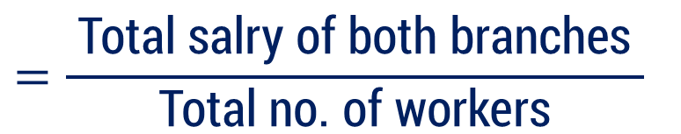
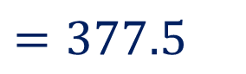
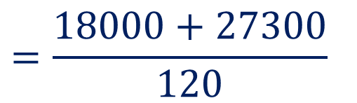
Method 1.1 ⇝ Example 5 (Continue)
Branch 1:
Branch 2:
No. of workers
$$f=50$$
No. of workers
$$g=70$$
Total salary paid by branch 1
$$=18000$$
Total salary paid by branch 2
$$=27300$$
Total no. of workers
$$=120$$
$$=\frac{ \text{Total} \text{salry} \text{of} \text{both} \text{branches} }{\text{Total} \text{no}\text{. }\text{of} \text{workers}}$$
Mean salary of all workers
$$=\frac{18000+27300}{120}$$
$$=377.5$$

Slide 25
Method 1.2 Median

Slide 26
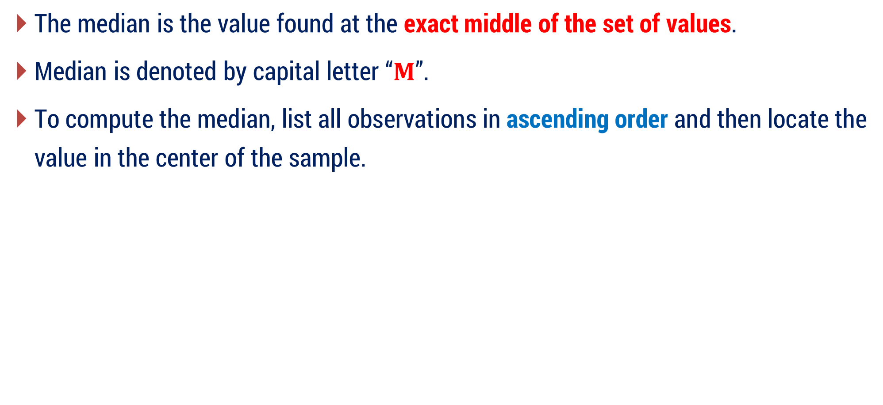
Median
The median is the value found at the exact middle of the set of values.
Median is denoted by capital letter “$M$”.
To compute the median, list all observations in ascending order and then locate the value in the center of the sample.

Slide 27

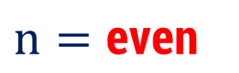
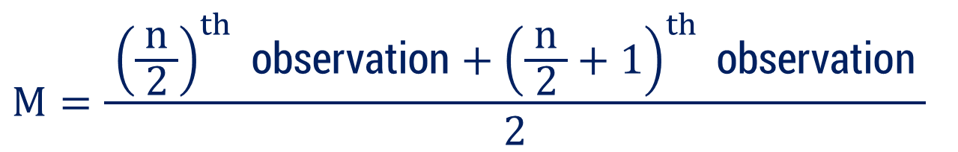
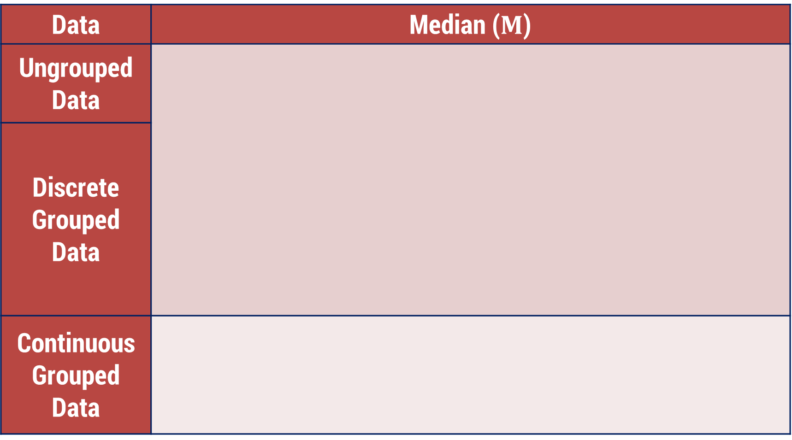
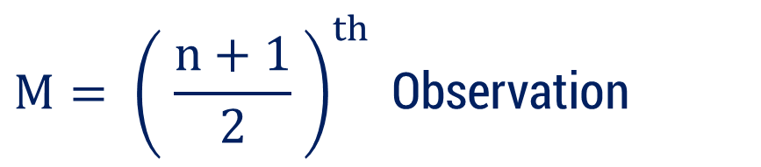
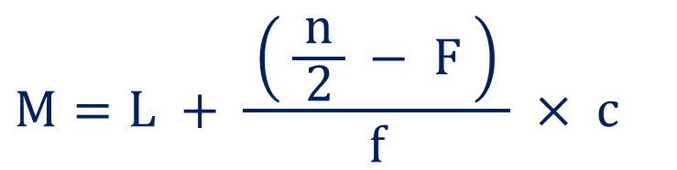
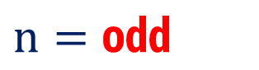

Median
Data | Median ($M$)
Ungrouped Data
Discrete Grouped Data
Continuous Grouped Data
$$M= {\left( \frac{n+1}{2} \right)}^{th} \text{Observation}$$
$$n=\text{odd}$$
$$⇒$$
$$n=\text{even}$$
$$M=\frac{ {\left(\frac{n}{ 2 }\right)}^{th} \text{observation}+{\left(\frac{n}{ 2 }+1\right)}^{th} \text{observation} }{2}$$
$$⇒$$
$$M=L + \frac{ \left( \frac{n}{ 2 } − F \right) }{f} × c$$

Slide 28
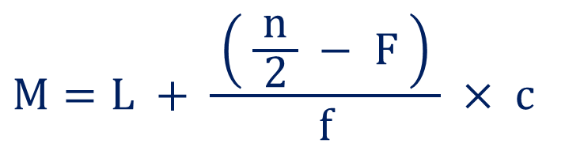
Median
$$M=L + \frac{ \left( \frac{n}{ 2 } − F \right) }{f} × c$$
Where,
$$\text{Median} \text{class}=\text{Class} \text{whose} \text{cumulative} \text{frequency} \text{with} \text{property}\min\left\{cf | cf≥\frac{n}{ 2 }\right\}$$
$$L= \text{Lower} \text{boundary} \text{point} \text{of} \text{the} \text{median} \text{class}$$
$$n= \text{Total} \text{number} \text{of} \text{observation}\text{ (}\text{sum} \text{of} \text{the} \text{frequencies}\text{)}$$
$$F= \text{Cumulative} \text{frequency} \text{of} \text{the} \text{class} \text{preceding} \text{the} \text{median} \text{class}$$
$$f = \text{The} \text{frequency} \text{of} \text{the} \text{median} \text{class}$$
$$c =\text{Class} \text{length}$$

Slide 29

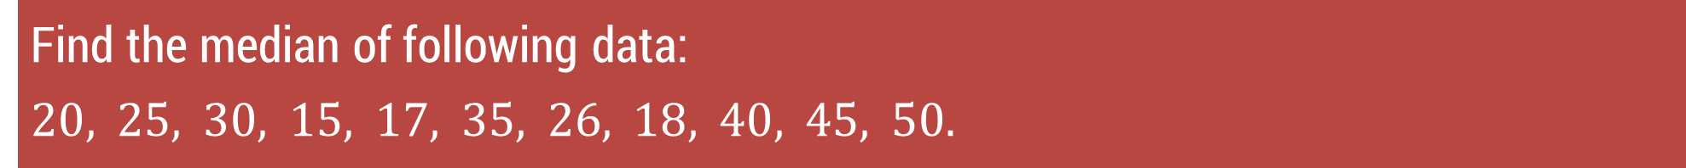
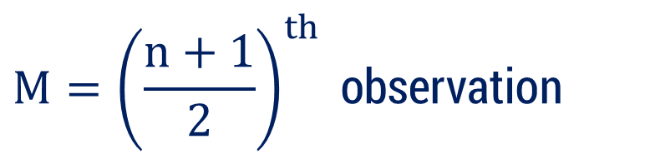
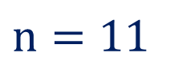
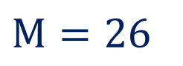

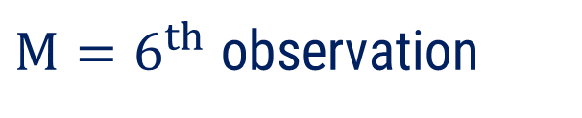

Method 1.2 ⇝ Example 1
Find the median of following data:
$$20, 25, 30, 15, 17, 35, 26, 18, 40, 45, 50.$$
Solution:
To compute the median,
arrange all observations in ascending order
$$15, 17, 18, 20, 25, 26, 30, 35, 40, 45, 50$$
Here
$$n=11$$
(odd)
$$M={\left(\frac{n+1}{2}\right)}^{th} \text{observation}$$
$$⇒$$
$$⇒$$
$M=6^{th}$ observation
$$⇒$$
$$M=26$$

Slide 30
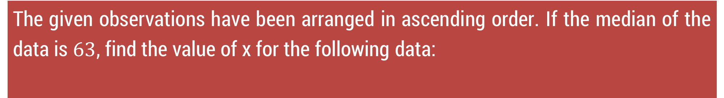
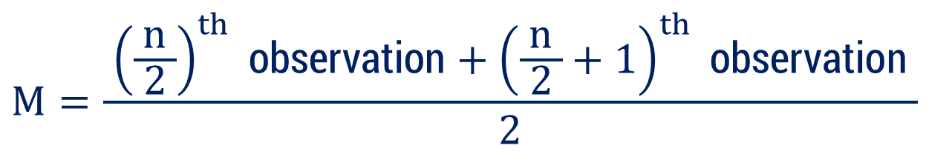
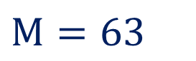
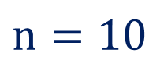
Method 1.2 ⇝ Example 2
The given observations have been arranged in ascending order. If the median of the data is $63$, find the value of x for the following data:
$$29, 32, 48, 50, x, x+2, 72, 78, 84, 95$$
Solution:
Given that,
$$M=63$$
$$n=10$$
(even)
So,
$$M=\frac{ {\left(\frac{n}{ 2 }\right)}^{th} \text{observation}+{\left(\frac{n}{ 2 }+1\right)}^{th} \text{observation} }{2}$$

Slide 31
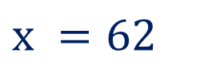
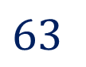
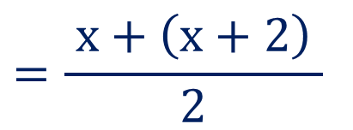

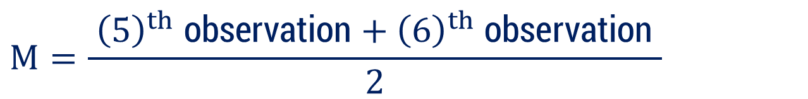

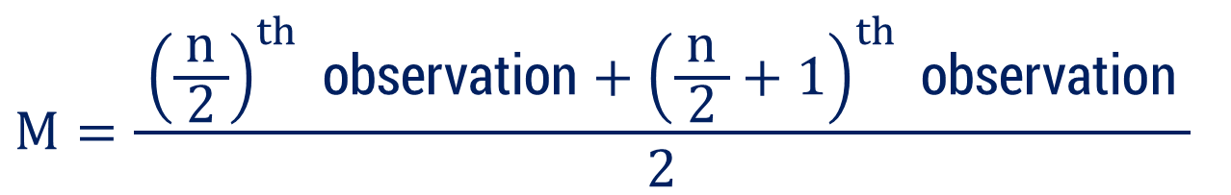

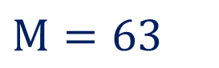
Method 1.2 ⇝ Example 2 (Continue)
$$29, 32, 48, 50, x, x+2, 72, 78, 84, 95$$
$$M=63$$
$$M=\frac{ {\left(\frac{n}{ 2 }\right)}^{th} \text{observation}+{\left(\frac{n}{ 2 }+1\right)}^{th} \text{observation} }{2}$$
$$M=\frac{ {\left(5\right)}^{th} \text{observation}+{\left(6\right)}^{th} \text{observation} }{2}$$
$$⇒$$
$$=\frac{ x+\left(x+2\right) }{2}$$
$$⇒$$
$$63$$
$$⇒$$
$$x =62$$

Slide 32
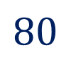
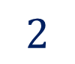
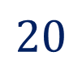
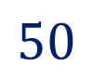
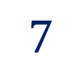
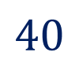
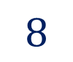
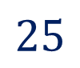
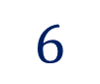
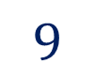
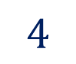
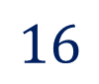
Method 1.2 ⇝ Example 3
Calculate the median for the following data:
Marks | 20 | 9 | 25 | 50 | 40 | 80
No. of students | 6 | 4 | 16 | 7 | 8 | 2
Solution:
Arrange the data in ascending order of marks.
Marks
No. of students
$$9$$
$$20$$
$$25$$
$$40$$
$$50$$
$$80$$
$$4$$
$$6$$
$$16$$
$$8$$
$$7$$
$$2$$

Slide 33
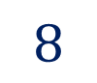
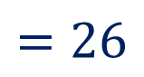
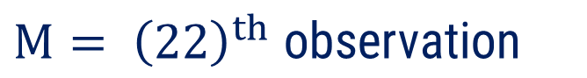
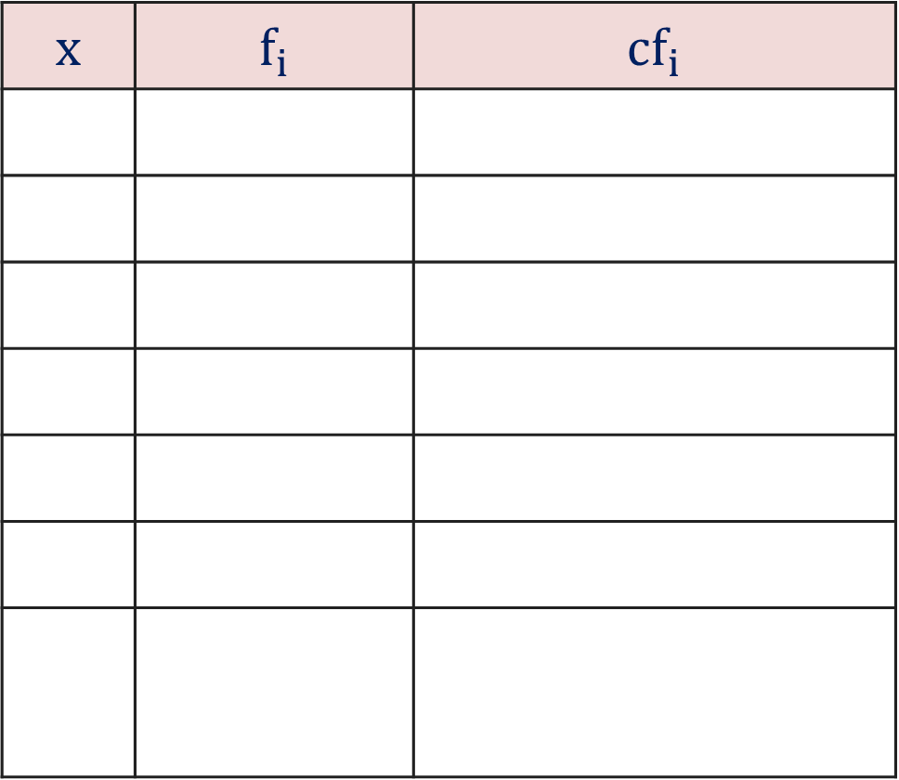
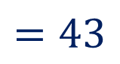
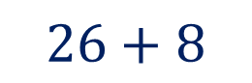


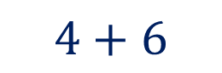
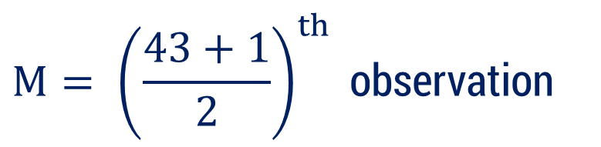
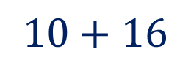
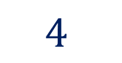
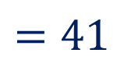

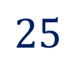



















Method 1.2 ⇝ Example 3 (Continue)
$$x$$ | $$f_{i}$$ | $$cf_{i}$$
Here,
$$n=43$$
(odd)
$$9$$
$$4$$
$$4$$
$$M= {\left(\frac{n+1}{2}\right)}^{th} \text{observation}$$
$$20$$
$$6$$
$$4+6$$
$$=10$$
$$⇒$$
$$25$$
$$16$$
$$10+16$$
$$=26$$
$$40$$
$$8$$
$$26+8$$
$$=34$$
$$M= {\left(\frac{43+1}{2}\right)}^{th} \text{observation}$$
$$⇒$$
$$50$$
$$7$$
$$34+7$$
$$=41$$
$$80$$
$$2$$
$$41+2$$
$$=43$$
$$⇒$$
$$M= {\left(22\right)}^{th} \text{observation}$$
$$\sum{f_{i}=}43$$
$$⇒$$
$$M=25$$

Slide 34












Method 1.2 ⇝ Example 4
The following table gives marks obtained by $50$ students in statistics. Find the median.
Marks
No. of students
$$0−10$$
$$10−20$$
$$20−30$$
$$30−40$$
$$40−50$$
$$16$$
$$12$$
$$18$$
$$3$$
$$1$$
Solution:
Formula to calculate median is
$$M=L+\frac{ \left( \frac{n}{ 2 } − F \right) }{f}×c$$

Slide 35



































Method 1.2 ⇝ Example 4 (Continue)
$$Class$$ | $$f_{i}$$ | $$cf_{i}$$
$$M=L+\frac{ \left( \frac{n}{ 2 } − F \right) }{f}×c$$
$$0−10$$
$$16$$
$$16$$
$$10−20$$
$$12$$
$$28$$
$$20−30$$
$$18$$
$$46$$
$$M=10+\frac{ \left(25−16\right) }{12}×10$$
$$⇒$$
$$30−40$$
$$3$$
$$49$$
$$40−50$$
$$1$$
$$50$$
$$M=10+\frac{ 15 }{2}$$
$$⇒$$
$$\sum{f_{i}}$$
$$\frac{n}{ 2 }=25$$
$$=n$$
$$=50$$
$$⇒$$
$$⇒$$
$$M=17.5$$
Median class :
$$10−20$$
$$⇒$$
$$L=10$$
$$f$$
$$=12$$
$$F$$
$$=16$$
$$c=10$$

Slide 36

















Method 1.2 ⇝ Example 5
The median of $60$ observations (following data) is $28.5$. Find $x$ and $y$
Marks
No. of students
$$0−10$$
$$10−20$$
$$20−30$$
$$30−40$$
$$40−50$$
$$50−60$$
$$5$$
$$x$$
$$20$$
$$15$$
$$y$$
$$5$$
Solution:
Given that
$$\sum{f_{i}}$$
$$M=28.5$$
$$=n=60$$
Formula to calculate median is
$$M=L+\frac{ \left( \frac{n}{ 2 } − F \right) }{f}×c$$

Slide 37




































Method 1.2 ⇝ Example 5 (Continue)
$$Class$$ | $$f_{i}$$ | $$cf_{i}$$
$$M=28.5$$
$$0−10$$
$$5$$
$$5$$
Median class :
$$20−30$$
$$⇒$$
$$L=20$$
$$10−20$$
$$x$$
$$5+x$$
$$f$$
$$=20$$
$$F$$
$$=5+x$$
$$20−30$$
$$20$$
$$25+x$$
$$c=10$$
$$30−40$$
$$15$$
$$40+x$$
$$40−50$$
$$y$$
$$40+x+y$$
Note that
$$50−60$$
$$5$$
$$45+x+y$$
$$45+x+y=60$$
$$⇒$$
$$x+y=15$$
$$\sum{f_{i}}$$
$$\frac{n}{ 2 }=30$$
$$=n=60$$
$$⇒$$
$$M=L+\frac{ \left( \frac{n}{ 2 } − F \right) }{f}×c$$

Slide 38






























Method 1.2 ⇝ Example 5 (Continue)
$$\frac{n}{ 2 }=30$$
$$M=28.5$$
$$L=20$$
$$f$$
$$=20$$
$$F$$
$$=5+x$$
$$c=10$$
$$x+y=15$$
$$M=L+\frac{ \left( \frac{n}{ 2 } − F \right) }{f}×c$$
$$⇒$$
$$\left( 8.5 \right) 2$$
$$=25−x$$
$$⇒$$
$$x$$
$$=25−17$$
$$⇒$$
$$x$$
$$=8$$
$$28.5=20+\frac{ \left[ 30−\left(5+x\right) \right] }{20}×10$$
$$⇒$$
Now,
$$x+y=15$$
$$=\frac{ 30−5−x }{2}$$
$$⇒$$
$$28.5−20$$
$$⇒$$
$$8+y=15$$
$$⇒$$
$$y$$
$$=7$$

Slide 39
Method 1.3 Mode

Slide 40

Mode
The mode is the most frequently occurring value in the set.
Mode is denoted by capital letter “$Z$”.
The mode is not necessarily unique, like mean and median.
We can have data with two modes (bi-modal) or
more than two modes (multi-modal) .

Slide 41


Mode
Data | Mode ($Z$)
Ungrouped Data
Discrete Grouped Data
Continuous Grouped Data
Most repeated observation among given data
Observation against the highest frequency
$$Z=L+\left(\frac{ f_{1}−f_{0} }{ 2f_{1}−f_{0}−f_{2} }\right)×c$$

Slide 42





Mode
$$Z=L+\left(\frac{ f_{1}−f_{0} }{ 2f_{1}−f_{0}−f_{2} }\right)×c$$
Where,
$$\text{Modal} \text{class}=\text{A} \text{class} \text{with} \text{highest} \text{frequency}$$
$L =$Lower boundary of modal class
$f_{1}$ $=$ Frequency of the modal class
(Highest frequency)
$f_{0}$ $=$ Frequency of the class before the modal class
$f_{2}$ $=$ Frequency of the class after the modal class
$c =$Class length

Slide 43

Relation Between Mean, Median, and Mode
The relation between the mean, median, and mode is given by the formula:
$$Z=3M−2\overline{x}$$
Where,
$\overline{x}=$Mean$, M=$Median$, Z=$Mode
It helps estimate one measure of central tendency when the other two are known.
This relation is useful for unimodal frequency distributions.

Slide 44







Method 1.3 ⇝ Example 2
Find the mode of following data:
$$\left(a\right) 2, 4, 2, 5, 7, 2, 8, 9.$$
$$\left(b\right) 2, 8, 4, 6, 10, 12, 4, 8, 14, 16.$$
Solution:
$$\left(a\right) 2, 4, 2, 5, 7, 2, 8, 9$$
Here,
Observation $2$ is repeated
Unimodal dataset
So,
$$Z=2$$
$$\left(b\right) 2, 8, 4, 6, 10, 12, 4, 8, 14, 16$$
Here,
Observation $8$ is repeated
Also,
Observation $4$ is repeated
Bimodal dataset
$$Z=4,$$
So,
$$8$$

Slide 45





Method 1.3 ⇝ Example 3
Find the mode of following data:
x | 11 | 22 | 33 | 44
f | 15 | 20 | 19 | 10
Solution:
x | 11 | 22 | 33 | 44
f | 15 | 20 | 19 | 10
For Discrete Grouped Data
Mode $\left(Z\right)$
$=$ Observation against the highest frequency
Here,
highest frequently in given data is
$$20$$
$$⇒$$
$$Z=22$$

Slide 46





















Method 1.3 ⇝ Example 4
Find the mode of following data:
Class
f
$$0−10$$
$$10−20$$
$$20−30$$
$$30−40$$
$$40−50$$
$$3$$
$$5$$
$$7$$
$$10$$
$$12$$
$$50−60$$
$$60−70$$
$$70−80$$
$$80−90$$
$$90−100$$
$$15$$
$$12$$
$$6$$
$$2$$
$$8$$
Solution:
Formula for the Mode
$$Z=L+\left(\frac{f_{1}−f_{0}}{ 2f_{1}−f_{0}−f_{2} }\right)×c$$

Slide 47







































Method 1.3 ⇝ Example 4 (Continue)
$$Class$$ | $$f_{i}$$
Modal class:
$$Z=L+\left(\frac{f_{1}−f_{0}}{ 2f_{1}−f_{0}−f_{2} }\right)×c$$
$$0−10$$
$$3$$
$$50−60$$
$$10−20$$
$$5$$
$$L=50$$
$$20−30$$
$$7$$
$$f_{0}$$
$$=12$$
$$Z=50+\left(\frac{15−12}{ 2\left(15\right)−12−12 }\right)×10$$
$$⇒$$
$$30−40$$
$$10$$
$$f_{1}$$
$$=15$$
$$40−50$$
$$12$$
$$f_{2}$$
$$=12$$
$$Z=50+\left(\frac{3}{ 30−24 }\right)×10$$
$$50−60$$
$$15$$
$$⇒$$
$$c=10$$
$$60−70$$
$$12$$
$$70−80$$
$$6$$
$$⇒$$
$$Z=50+5$$
$$80−90$$
$$2$$
$$90−100$$
$$8$$
$$⇒$$
$$Z=55$$

Slide 48














Method 1.3 ⇝ Example 5
Find the mode of following data:
Class
f
$$200−220$$
$$220−240$$
$$240−260$$
$$260−280$$
$$280−300$$
$$7$$
$$15$$
$$21$$
$$19$$
$$6$$
$$300−320$$
$$320−340$$
$$4$$
$$2$$
Solution:
Formula for the Mode
$$Z=L+\left(\frac{f_{1}−f_{0}}{ 2f_{1}−f_{0}−f_{2} }\right)×c$$

Slide 49


































Method 1.3 ⇝ Example 5 (Continue)
$$Z=L+\left(\frac{f_{1}−f_{0}}{ 2f_{1}−f_{0}−f_{2} }\right)×c$$
$$Class$$ | $$f_{i}$$
$$⇒$$
Modal class:
$$200−220$$
$$7$$
$$240−260$$
$$Z=240+\left(\frac{21−15}{ 2\left(21\right)−15−19 }\right)×20$$
$$220−240$$
$$15$$
$$⇒$$
$$21$$
$$L=240$$
$$240−260$$
$$260−280$$
$$19$$
$$f_{0}$$
$$=15$$
$$Z=240+\left(\frac{ 6 }{8}\right)×20$$
$$280−300$$
$$6$$
$$f_{1}$$
$$=21$$
$$⇒$$
$$300−320$$
$$4$$
$$f_{2}$$
$$=19$$
$$320−340$$
$$2$$
$$c=20$$
$$⇒$$
$$Z=240+15$$
$$⇒$$
$$Z=255$$

Slide 50






























Method 1.3 ⇝ Example 6
Obtain the mean, mode and median for the following information:
x | < 10 | < 20 | < 30 | < 40 | < 50 | < 60
f | 12 | 30 | 57 | 77 | 94 | 100
Solution:
$$Class$$ | $$f_{i}$$
$$cf_{i}$$
$$0−10$$
$$12$$
$$12$$
Firstly we will calculate
$$10−20$$
$$30−12$$
$$=$$
$$18$$
$$30$$
Median
$$20−30$$
$$57−30$$
$$=$$
$$27$$
$$57$$
$$30−40$$
$$77−57$$
$$=$$
$$20$$
$$77$$
$$40−50$$
$$94−77$$
$$=$$
$$17$$
$$94$$
$$50−60$$
$$100−94$$
$$=$$
$$6$$
$$100$$

Slide 51








































Method 1.3 ⇝ Example 6 (Continue)
Mean (Direct Method)
Median
$$Class$$ | $$f_{i}$$
$$cf_{i}$$
Median class :
$$M=L+\frac{ \left( \frac{n}{ 2 } − F \right) }{f}×c$$
$$0−10$$
$$12$$
$$12$$
$$20−30$$
$$10−20$$
$$18$$
$$30$$
$$L=20$$
$$20−30$$
$$27$$
$$57$$
$$M=20+\frac{ \left(50−30\right) }{27}×10$$
$$f$$
$$=27$$
$$⇒$$
$$30−40$$
$$20$$
$$77$$
$$F$$
$$=30$$
$$40−50$$
$$17$$
$$94$$
$$⇒$$
$$M=20+7.41$$
$$c=10$$
$$50−60$$
$$6$$
$$100$$
$$⇒$$
$$M=27.41$$
$$\sum{f_{i}}$$
$$\frac{n}{ 2 }=50$$
$$=$$
$$n$$
$$=100$$
$$⇒$$

Slide 52





















Method 1.3 ⇝ Example 6 (Continue)
Mode
Mean (Direct Method)
$$Class$$ | $$f_{i}$$
$$x_{i}$$ | $$f_{i}x_{i}$$
$$\overline{x}=\frac{\sum{f_{i}x_{i}} }{\sum{f_{i}}}$$
$$0−10$$
$$12$$
$$5$$
$$60$$
$$10−20$$
$$18$$
$$15$$
$$270$$
$$\overline{x}=\frac{2800 }{100 }$$
$$⇒$$
$$20−30$$
$$27$$
$$25$$
$$675$$
$$30−40$$
$$20$$
$$35$$
$$700$$
$$⇒$$
$$\overline{x}=28$$
$$40−50$$
$$17$$
$$45$$
$$765$$
$$50−60$$
$$6$$
$$55$$
$$330$$
$$\sum{f_{i}}x_{i}=2800$$
$$\sum{f_{i}}$$
$$=100$$

Slide 53


















Method 1.3 ⇝ Example 6 (Continue)
Mode
Modal class:
$$Class$$ | $$f_{i}$$
$$Z=L+\left(\frac{f_{1}−f_{0}}{ 2f_{1}−f_{0}−f_{2} }\right)×c$$
$$20−30$$
$$0−10$$
$$12$$
$$L=20$$
$$10−20$$
$$18$$
$$Z=20+\left(\frac{27−18}{ 2\left(27\right)−18−20 }\right)×10$$
$$f_{0}$$
$$=18$$
$$⇒$$
$$20−30$$
$$27$$
$$30−40$$
$$20$$
$$f_{1}$$
$$=27$$
$$Z=20+\left(\frac{9}{ 54−38 }\right)×10$$
$$40−50$$
$$17$$
$$f_{2}$$
$$=20$$
$$⇒$$
$$50−60$$
$$6$$
$$c=10$$
$$Z=20+\left(\frac{9}{ 16 }\right)×10$$
$$⇒$$
$$⇒$$
$$Z=25.63$$

Slide 54
Method 1.4 Quartiles

Slide 55

Quartiles
Quartiles are measures which divide a series into four equal parts using three quartiles namely$Q_{1}$, $Q_{2}$ and $Q_{3}$.
The quartile $Q_{1}$ is known as first quartile or lower quartile,
The quartile $Q_{2}$ is known as second quartile or median quartile,
The quartile $Q_{3}$ is known as third quartile or upper quartile.
To compute the quartile, list all observations in ascending order.
Table of formula of quartile.

Slide 56








Quartiles
Data | Quartiles
Ungrouped Data
Discrete Grouped Data
Continuous Grouped Data
$$Q_{1}= {\left( \frac{ n+1 }{4} \right)}^{th} \text{Observation}$$
$$⇒$$
$$⇒$$
$$Q_{2}= \text{Median}$$
$$Q_{3}={\left( \frac{ 3\left(n+1\right) }{4}\right)}^{th} \text{Observation}$$
$$⇒$$
$$Q_{1}=L + \left(\frac{ \frac{ n }{4}−F }{f}\right)× c,$$
$$Q_{2}=L + \left( \frac{ \frac{ n }{2}−F }{f}\right)× c$$
$$Q_{3}=L + \left(\frac{ \frac{ 3n}{4}−F }{f} \right)× c$$

Slide 57

Quartiles
Where,
$$\text{Quartile} \text{class} Q_{k}$$
$=$Class whose cumulative frequency with property min $\left\{cf \right| cf≥\frac{ kn }{4}\}$
$L$ $=$ Lower boundary point of the quartile class
$n$ $=$ Total number of observation (sum of the frequencies)
$F$ $=$ Cumulative frequency of the class preceding the quartile class
$f =$The frequency of the quartile class

Slide 58








Method 1.4 ⇝ Example 1
Find the quartiles of the data : 4, 6, 7, 8, 10, 23, 34
Solution:
Step 1: Arrange the data in ascending order (which it already is):
$$⇒$$
$$4, 6, 7, 8, 10, 23, 34$$
Median$(Q_{2})=8$
$$⇒$$
Step 2: Find the median ($Q_{2}$):
$$⇒$$
Step 3: Find the lower quartile ($Q_{1}$):
Median of the lower half of the data
$$⇒$$
The lower half is: 4,6,7 the median of this subset is: $Q_{1}=6$
$$⇒$$
Step 4: Find the upper quartile ($Q_{4}$):
Median of the upper half of the data.
$$⇒$$
The upper half is: 10, 23, 34 the median of this subset is: $Q_{3}=23$

Slide 59













Method 1.4 ⇝ Example 2
Calculate the quartile$Q_{1}$ and $Q_{3}$
X | 2 | 4 | 6 | 8 | 10 | 12
f | 4 | 1 | 2 | 3 | 4 | 5
Solution:
We have,
X
f
$$2$$
$$4$$
$$6$$
$$8$$
$$10$$
$$12$$
$$4$$
$$1$$
$$2$$
$$3$$
$$4$$
$$5$$

Slide 60


































Method 1.4 ⇝ Example 2 (Continue)
$$x$$ | $$f_{i}$$ | $$cf_{i}$$
Here,
$$n=19$$
$$2$$
$$4$$
$$4$$
$$Q_{1}= {\left(\frac{n+1}{4}\right)}^{th} \text{observation}$$
$$4$$
$$1$$
$$4+1$$
$$=5$$
$$⇒$$
$$6$$
$$2$$
$$5+2$$
$$=7$$
$$8$$
$$3$$
$$7+3$$
$$=10$$
$$Q_{1}= {\left(\frac{19+1}{4}\right)}^{th} \text{observation}$$
$$⇒$$
$$10$$
$$4$$
$$10+4$$
$$=14$$
$$12$$
$$5$$
$$14+5$$
$$=19$$
$$⇒$$
$$Q_{1}= {\left(5\right)}^{th} \text{observation}$$
$$n=19$$
$$⇒$$
$$Q_{1}=4$$

Slide 61




Method 1.4 ⇝ Example 2 (Continue)
$$x$$ | $$f_{i}$$ | $$cf_{i}$$
Here,
$$n=19$$
$$2$$
$$4$$
$$4$$
$$Q_{3}= {\left(\frac{3(n+1)}{4}\right)}^{th} \text{obser}\text{.}$$
$$4$$
$$1$$
$$4+1$$
$$=5$$
$$⇒$$
$$6$$
$$2$$
$$5+2$$
$$=7$$
$$8$$
$$3$$
$$7+3$$
$$=10$$
$$Q_{3}= {\left(\frac{3(19+1)}{4}\right)}^{th} \text{obser}\text{.}$$
$$⇒$$
$$10$$
$$4$$
$$10+4$$
$$=14$$
$$12$$
$$5$$
$$14+5$$
$$=19$$
$$⇒$$
$$Q_{3}= {\left(15\right)}^{th} \text{observation}$$
$$n=19$$
$$⇒$$
$$Q_{3}=12$$

Slide 62

Method 1.4 ⇝ Example 3
Compute $Q_{1} and Q_{3}$ for the data relating to age in years of 543 members in a village.
X | 20 | 30 | 40 | 50 | 60
f | 3 | 61 | 132 | 153 | 140
70 | 80
51 | 3
Solution:

Slide 63


































Method 1.4 ⇝ Example 3 (Continue)
$$x$$ | $$f_{i}$$ | $$cf_{i}$$
Here,
$$n=543$$
$$20$$
$$3$$
$$3$$
$$Q_{1}= {\left(\frac{n+1}{4}\right)}^{th} \text{observation}$$
$$30$$
$$61$$
$$61+3$$
$$=64$$
$$⇒$$
$$40$$
$$132$$
$$64+132$$
$$=196$$
$$50$$
$$153$$
$$196+153$$
$$=349$$
$$Q_{1}= {\left(\frac{543+1}{4}\right)}^{th} \text{obser}\text{.}$$
$$⇒$$
$$60$$
$$140$$
$$349+140$$
$$=489$$
$$70$$
$$51$$
$$489+51$$
$$=540$$
$$⇒$$
$$Q_{1}= {\left(136\right)}^{th} \text{observation}$$
$$80$$
$$3$$
$$n=543$$
$$540+3$$
$$=543$$
$$⇒$$
$$Q_{1}=40$$

Slide 64










Method 1.4 ⇝ Example 3 (Continue)
$$x$$ | $$f_{i}$$ | $$cf_{i}$$
Here,
$$n=543$$
$$20$$
$$3$$
$$3$$
$$Q_{3}= {\left(\frac{3(n+1)}{4}\right)}^{th} \text{obser}$$
$$30$$
$$61$$
$$61+3$$
$$=64$$
$$⇒$$
$$40$$
$$132$$
$$64+132$$
$$=196$$
$$50$$
$$153$$
$$196+153$$
$$=349$$
$$Q_{3}= {\left(\frac{3(543+1)}{4}\right)}^{th} \text{obser}\text{.}$$
$$⇒$$
$$60$$
$$140$$
$$349+140$$
$$=489$$
$$70$$
$$51$$
$$489+51$$
$$=540$$
$$⇒$$
$$Q_{3}= {\left(408\right)}^{th} \text{observation}$$
$$80$$
$$3$$
$$n=543$$
$$540+3$$
$$=543$$
$$⇒$$
$$Q_{3}=60$$

Slide 65

Method 1.4 ⇝ Example 4
Compute $Q_{1} and Q_{3}$ for the data relating to age in years of 543 members in a village.
X | 30-32 | 32-34 | 34-36 | 36-38 | 38-40
f | 12 | 18 | 16 | 14 | 12
40-42 | 42-44
8 | 6
Solution:

Slide 66





































Method 1.4 ⇝ Example 4 (Continue)
$$x$$ | $$f_{i}$$ | $$cf_{i}$$
$$⇒$$
$Q_{1}$ Class:
$$30−32$$
$$12$$
$$12$$
$$Q_{1}= {\left(\frac{ n }{4}\right)}^{th} \text{obser}$$
$$32−34$$
$$18$$
$$12+18$$
$$=30$$
$$⇒$$
$$\text{in} \text{cf} \text{coloumn}$$
$$34−36$$
$$16$$
$$30+16$$
$$=46$$
$$Q_{1}= {\left(\frac{ 86 }{4}\right)}^{th}\text{obser}$$
$$⇒$$
$$\text{in} \text{cf} \text{coloumn}$$
$$36−38$$
$$14$$
$$46+14$$
$$=60$$
$$38−40$$
$$12$$
$$60+12$$
$$=72$$
$$⇒$$
$Q_{1}= {\left(21.5\right)}^{th}$ value of the obs.
$$40−42$$
$$8$$
$$72+8$$
$$=80$$
$$n=86$$
$$\text{in} \text{cf} \text{coloumn}$$
Here,
$$n=86$$

Slide 67










Method 1.4 ⇝ Example 4 (Continue)
$$x$$ | $$f_{i}$$ | $$cf_{i}$$
$$⇒$$
and it lies in the class $32−34$
$$30−32$$
$$12$$
$$12$$
$$⇒$$
$Q_{1}$ Class: $32−34$
$$32−34$$
$$18$$
$$12+18$$
$$=30$$
$$⇒$$
The lower boundary point of
$32−34$ is $32$.
$$34−36$$
$$16$$
$$30+16$$
$$=46$$
$$36−38$$
$$14$$
$$46+14$$
$$=60$$
$$38−40$$
$$12$$
$$60+12$$
$$=72$$
$$⇒$$
$$L=32$$
$$40−42$$
$$8$$
$$72+8$$
$$=80$$
$$n=86$$
Here,
$$n=86$$

Slide 68










Method 1.4 ⇝ Example 4 (Continue)
$$x$$ | $$f_{i}$$ | $$cf_{i}$$
$$Q_{1}=L + \left(\frac{ \frac{ n }{4}−F }{f}\right)× c$$
$$30−32$$
$$⇒$$
$$12$$
$$12$$
$$32−34$$
$$18$$
$$12+18$$
$$=30$$
$$Q_{1}=32 + \left(\frac{ 21.5−12 }{18}\right)×2$$
$$⇒$$
$$34−36$$
$$16$$
$$30+16$$
$$=46$$
$$36−38$$
$$14$$
$$46+14$$
$$=60$$
$$Q_{1}=32 + \left(\frac{ 9.5}{18}\right)×2$$
$$38−40$$
$$12$$
$$60+12$$
$$=72$$
$$⇒$$
$$40−42$$
$$8$$
$$72+8$$
$$=80$$
$$n=86$$
$$⇒$$
$$Q_{1}=32 +1.0556$$
$$⇒$$
$$Q_{1}=33.0556$$
Here,
$$n=86$$

Slide 69







Method 1.4 ⇝ Example 4 (Continue)
$$x$$ | $$f_{i}$$ | $$cf_{i}$$
Here,
$$n=86$$
$$30−32$$
$$12$$
$$12$$
$$Q_{3} \text{Class}:$$
$$32−34$$
$$18$$
$$12+18$$
$$=30$$
$${\left(\frac{3n}{4}\right)}^{th} \text{observation}$$
$$⇒$$
Class with
$$34−36$$
$$16$$
$$30+16$$
$$=46$$
$$36−38$$
$$14$$
$$46+14$$
$$=60$$
$$= {\left(\frac{(3)(86) }{4}\right)}^{th} \text{obser}\text{vation}$$
$$38−40$$
$$12$$
$$60+12$$
$$=72$$
$$40−42$$
$$8$$
$$72+8$$
$$=80$$
$$n=86$$
$$= {\left(64.5\right)}^{th} \text{obser}\text{vation}$$
Here,
$$n=86$$
and it lies in the class $38−40.$

Slide 70







Method 1.4 ⇝ Example 4 (Continue)
$$x$$ | $$f_{i}$$ | $$cf_{i}$$
The lower boundary point of $38 – 40$is $38$
$$30−32$$
$$12$$
$$12$$
$$12+18$$
$$=30$$
∴$L=38$
$$32−34$$
$$18$$
$$Q_{3}=L + \left(\frac{ \frac{ 3n }{4}−F }{f} \right)× c$$
$$34−36$$
$$16$$
$$30+16$$
$$=46$$
$$36−38$$
$$14$$
$$46+14$$
$$=60$$
$$Q_{3}=38 + \left(\frac{ 64.5−60 }{12} \right)×2$$
$$38−40$$
$$12$$
$$60+12$$
$$=72$$
$$40−42$$
$$8$$
$$72+8$$
$$=80$$
$$n=86$$
$$Q_{3}=38 + \left(\frac{ 4.5}{12} \right)×2$$
∴${ Q}_{3}$ class : $38−40$
$$Q_{3}=38 +0.75=38.75$$

Slide 71

Method 1.4 ⇝ Example 5
Compute $Q_{1} and Q_{3}$ for the following data
Marks | < 20 | 20-30 | 30-40 | 40 <
Number of Students | 14 | 20 | 28 | 18
Solution:

Slide 72




























Method 1.4 ⇝ Example 5 (Continue)
$$Marks$$ | $$No. of std.$$ | $$cf_{i}$$
$$⇒$$
$Q_{1}$ Class:
$$10−20$$
$$14$$
$$14$$
$$Q_{1}= {\left(\frac{ n }{4}\right)}^{th} \text{obser}$$
$$20−30$$
$$20$$
$$14+20$$
$$=34$$
$$⇒$$
$$\text{in} \text{cf} \text{coloumn}$$
$$30−40$$
$$28$$
$$34+28$$
$$=62$$
$$Q_{1}= {\left(\frac{ 80 }{4}\right)}^{th}\text{obser}$$
$$40−50$$
$$18$$
$$62+18$$
$$=80$$
$$⇒$$
$$\text{in} \text{cf} \text{coloumn}$$
$$n=80$$
$$⇒$$
$Q_{1}= {\left(20\right)}^{th}$ value of the obs.
$$\text{in} \text{cf} \text{coloumn}$$
Here,
$$n=80$$

Slide 73










Method 1.4 ⇝ Example 5 (Continue)
$$Marks$$ | $$No. of std.$$ | $$cf_{i}$$
$$⇒$$
and it lies in the class $20−30$
$$10−20$$
$$14$$
$$14$$
$$⇒$$
$Q_{1}$ Class: $20−30$
$$20−30$$
$$20$$
$$14+20$$
$$=34$$
$$28$$
$$⇒$$
The lower boundary point of
$20−30$ is $20$.
$$30−40$$
$$34+28$$
$$=62$$
$$40−50$$
$$18$$
$$62+18$$
$$=80$$
$$n=80$$
$$⇒$$
$$L=20$$
Here,
$$n=80$$

Slide 74




Method 1.4 ⇝ Example 5 (Continue)
$$Marks$$ | $$No. of std.$$ | $$cf_{i}$$
$$Q_{1}=L + \left(\frac{ \frac{ n }{4}−F }{f}\right)× c$$
$$⇒$$
$$10−20$$
$$14$$
$$14$$
$$20−30$$
$$20$$
$$14+20$$
$$=34$$
$$Q_{1}=20 + \left(\frac{ 20−14 }{20}\right)×10$$
$$28$$
$$⇒$$
$$30−40$$
$$34+28$$
$$=62$$
$$40−50$$
$$18$$
$$62+18$$
$$=80$$
$$n=80$$
$$Q_{1}=20 + \left(\frac{ 6}{20}\right)×10$$
$$⇒$$
Here,
$$n=80$$
$$⇒$$
$$Q_{1}=20+2$$
$$⇒$$
$$Q_{1}=23$$

Slide 75
















Method 1.4 ⇝ Example 5 (Continue)
$$Marks$$ | $$No. of std.$$ | $$cf_{i}$$
∴$L=30$
$$10−20$$
$$14$$
$$14$$
$$Q_{3}=L + \left(\frac{ \frac{ 3n}{4}−F }{f} \right)× c$$
$$20−30$$
$$20$$
$$14+20$$
$$=34$$
$$30−40$$
$$28$$
$$34+28$$
$$=62$$
$$Q_{3}=30 + \left(\frac{ 60−34 }{28} \right)×10$$
$$40−50$$
$$18$$
$$62+18$$
$$=80$$
$$n=80$$
$$Q_{3}=38 + \left(\frac{ 26}{28} \right)×10$$
∴${ Q}_{3}$ class : $30−40.$
$$Q_{3}=30+9.2857=39.28$$
The lower boundary point of $30 – 40 is 30$

Slide 76

Percentiles
Percentiles are measures which divide a series into hundred equal parts.
There are ninety-nine percentiles which is
The percentile $P_{1}$is known as first percentile,
The percentile $P_{2}$ is known as second percentile and so on.
To compute the percentile, list all observations in ascending order.
Table of formula of percentile.

Slide 77








Percentiles
Data | Percentiles
Ungrouped Data
Discrete Grouped Data
Continuous Grouped Data
$$P_{1}= {\left( \frac{ n+1 }{100} \right)}^{th} \text{Observation}$$
$$P_{2}=2{\left( \frac{ n+1 }{100} \right)}^{th} \text{Observation}$$
$$P_{99}=99{\left( \frac{ n+1 }{100} \right)}^{th} \text{Observation}$$
$$P_{k}=k{\left( \frac{ n+1 }{100} \right)}^{th} \text{Observation}$$
$$P_{1}=L + \left(\frac{ \frac{ n }{100}−F }{f}\right)× c,$$
$$P_{2}=L +2\left(\frac{ \frac{ n }{100}−F }{f}\right)× c,$$
$$P_{99}=L +99 \left(\frac{ \frac{ n }{100}−F }{f}\right)× c,$$
$$P_{k}=L +k \frac{\left(\frac{n}{100}\right)}{f}× c$$

Slide 78
Percentiles
Where,
$$\text{Quartile} \text{class} P_{k}$$
$=$Class whose cumulative frequency with property min $\left\{cf \right| cf≥\frac{ kn }{100}\}$
$L$ $=$ Lower boundary point of the quartile class
$n$ $=$ Total number of observation (sum of the frequencies)
$F$ $=$ Cumulative frequency of the class preceding the quartile class
$f =$The frequency of the quartile class

Slide 79










Method 1.5 ⇝ Example 1
Find ${20}^{th}$ Percentile of the data: 4, 6, 7, 8, 10, 23, 34, 55, 60.
Solution:
Step 1: Arrange the data in ascending order (which it already is):
$$⇒$$
$$4, 6, 7, 8, 10, 23, 34, 55, 60$$
$$⇒$$
H$ere (n)=9$
$$⇒$$
$2^{nd} \text{value} \text{of} \text{the} \text{obser}$.
$$P_{20}={\left( \frac{20(n+1) }{100} \right)}^{th} \text{Observation}$$
$$⇒$$
$$=6$$
$$⇒$$
$$P_{20}={\left( \frac{20(10) }{100} \right)}^{th} \text{Observation}$$
$$⇒$$

Slide 80

Method 1.5 ⇝ Example 2
Find ${20}^{th}$ Percentile of the data
X | 2 | 4 | 6 | 8 | 10 | 12
f | 4 | 1 | 2 | 3 | 4 | 5
Solution:
We have,
X
f
$$2$$
$$4$$
$$6$$
$$8$$
$$10$$
$$12$$
$$4$$
$$1$$
$$2$$
$$3$$
$$4$$
$$5$$

Slide 81




Method 1.4 ⇝ Example 2 (Continue)
$$x$$ | $$f_{i}$$ | $$cf_{i}$$
Here,
$$n=19$$
$$2$$
$$4$$
$$4$$
$$P_{30}= {\left(\frac{30(n+1)}{100}\right)}^{th} \text{obser}\text{.}$$
$$4$$
$$1$$
$$4+1$$
$$=5$$
$$⇒$$
$$6$$
$$2$$
$$5+2$$
$$=7$$
$$8$$
$$3$$
$$7+3$$
$$=10$$
$$P_{30}= {\left(\frac{(30)(20) }{100}\right)}^{th} \text{obser}\text{.}$$
$$⇒$$
$$10$$
$$4$$
$$10+4$$
$$=14$$
$$12$$
$$5$$
$$14+5$$
$$=19$$
$$⇒$$
$$P_{30}= {\left(6\right)}^{th} \text{observation}$$
$$n=19$$
$$⇒$$
$$P_{30}=6$$

Slide 82

Method 1.5 ⇝ Example3
Find ${51}^{th}$ Percentile of the data
Marks | 15-20 | 20-25 | 25-30 | 30-35 | 35-40
No. of Students | 2 | 12 | 15 | 20 | 25
Solution:
We have,

Slide 83



































Method 1.5 ⇝ Example 3 (Continue)
$$P_{51}= {\left( \frac{ (51)(74) }{100} \right)}^{th}$$
$$Marks$$ | $$No. of std.$$ | $$cf_{i}$$
$$⇒$$
Obser.
$$15−20$$
$$2$$
$$2$$
In$cf$ column
$$20−25$$
$$12$$
$$2+12$$
$$=14$$
$$P_{51}= {\left( \frac{ (37)(74) }{100} \right)}^{th}$$
$$25−30$$
$$15$$
$$14+15$$
$$=29$$
$$⇒$$
Obser.
$$30−35$$
$$20$$
$$29+20$$
$$=49$$
In$cf$ column
$$35−40$$
$$25$$
$$49+25$$
$$=74$$
$$⇒$$
$$P_{51}= {\left( 37.74\right)}^{th}$$
Obser.
$$n=74$$
Here,
$$n=74$$
In$cf$ column
$$P_{51}= {\left( \frac{ 51∙n }{100} \right)}^{th}$$
and it lies in the class $30−35$
$$⇒$$
Obser. In$cf$ column

Slide 84













Method 1.5 ⇝ Example 3 (Continue)
$$Marks$$ | $$No. of std.$$ | $$cf_{i}$$
$$P_{51}=L+\frac{\frac{51∙n}{100}−cf}{f}×c$$
$$15−20$$
$$2$$
$$2$$
$$⇒$$
$$20−25$$
$$12$$
$$2+12$$
$$=14$$
$$15$$
$$14+15$$
$$=29$$
$$P_{51}=30+\frac{37.74−29}{20}×5$$
$$25−30$$
$$⇒$$
$$30−35$$
$$20$$
$$29+20$$
$$=49$$
$$P_{51}=30+\frac{8.74}{20}×5$$
$$35−40$$
$$25$$
$$49+25$$
$$=74$$
$$⇒$$
$$n=74$$
$$⇒$$
$$P_{51}=30+2.185$$
$∴P_{51}$ class $30−35$
$$⇒$$
$$P_{51}=32.185$$
$$⇒$$
$$L=30$$

Slide 85
Method 3 Measure of Variability

Slide 86

Measure of Variability
Measure of Variability :
It refers to the spread of the values around the central tendency.
It is known as Measure of Dispersion.
For example:
$−5, 0, 5$ and $−50, 0, 50$ both have the same mean $0$ but clearly the data given in the second case much more widely dispersed than those in the first case.
So, measures of central tendency are not sufficient for having some idea about dispersion.

Slide 87

Measure of Variability
Measures of dispersion gives the idea about the degree to which numerical data tend to spread about an average life.
There are certain measures of variability,
Range
Interquartile Range
Standard Deviation $\left( σ \right)$
Mean Deviation

Slide 88

Range
Range is simply the highest value minus the lowest value of a set of data values.
For example:
Range of $−5, 0, 5$ is $10$
Reason:
$$\text{Range}=\text{Highest} \text{value}−\text{L}\text{owest} \text{value}$$
$$=5−\left(−5\right)$$
$$=10$$

Slide 89

Interquartile Range
The difference between the upper and lower quartile is known as the interquartile range.
For example:
Interquartile range $=$upper Quartile – lower Quartile
$$=Q_{3}−Q_{1}$$

Slide 90

Standard Deviation
Standard deviation is a measure that is used to quantify the amount of variation or dispersion of a set of data values.
It is denoted by “$σ$" and read as “sigma”.

Slide 91




Standard Deviation
Method | Ungrouped Data | Discrete Grouped Data | Continuous Grouped Data
Direct Method
Assumed Mean Method
$$\sqrt{ \frac{\sum{x_{i}^{2}} }{n }−{\left(\frac{ \sum{x_{i}} }{n }\right)}^{2} }$$
$$\sqrt{ \frac{\sum{f_{i}x_{i}^{2}} }{\sum{f_{i}} }−{\left(\frac{ \sum{f_{i}x_{i}} }{\sum{f_{i}}}\right)}^{2} }$$
$$\sqrt{ \frac{\sum{d_{i}^{2}} }{n }−{\left(\frac{ \sum{d_{i}} }{n }\right)}^{2} }$$
$$\sqrt{ \frac{\sum{f_{i}d_{i}^{2}} }{\sum{f_{i}} }−{\left(\frac{ \sum{f_{i}d_{i}} }{\sum{f_{i}}}\right)}^{2} }$$

Slide 92

Standard Deviation
Method | Ungrouped Data | Discrete Grouped Data | Continuous Grouped Data
Step Deviation Method
$$\sqrt{\frac{ \sum{ f_{i}u_{i}^{2}} }{ \sum{ f_{i}}}−{\left(\frac{ \sum{ f_{i}u_{i}} }{ \sum{f_{i}} }\right)}^{2} }×c$$
-----
-----

Slide 93

Variance
Variance is expectation of the squared deviation.
It informally measures how far a set of (random) numbers are spread out from their mean.
It is denoted by capital letter “$V$” and defined as $V=σ^{2}$.

Slide 94

Coefficient of Variation
The Coefficient of Variation is the ratio of the standard deviation to the mean and shows the extent of variability in relation to the mean of the population.
Coefficient of Variance is defined as
$$C.V.=\frac{ σ }{\overline{x}}×100$$
If $C.V.$ is high, then it is less consistent. Similarly, if $C.V.$ is less, then it is more consistent.
The higher the Coefficient of Variation, the greater the dispersion.

Slide 95
Mean Deviation
The mean deviation is defined as a statistical measure that is used to calculate the average deviation from the mean value of the given data set.
In a simple word, the mean deviation is used to calculate how far the values fall from the middle of the data set.

Slide 96






Mean Deviation
Method | Ungrouped Data | Grouped Data
M.D. about Mean
M.D. about Median
M.D. about Mode
$$\frac{ \sum{\left| x_{i}−\overline{ x } \right| }}{n}$$
$$\frac{ \sum{f_{i} \left| x_{i}−\overline{ x } \right| }}{\sum{f_{i} }}$$
$$\frac{ \sum{\left| x_{i}−M \right| }}{n}$$
$$\frac{ \sum{f_{i} \left| x_{i}−M \right| }}{\sum{f_{i} }}$$
$$\frac{ \sum{\left| x_{i}−Z \right| }}{n}$$
$$\frac{ \sum{f_{i} \left| x_{i}−Z \right| }}{\sum{f_{i} }}$$

Slide 97

















Method 3 ⇝ Example 1
Determine the interquartile range value for 2, 3, 5, 7, 11, 13, 17, 19, 23, 29.
Solution:
Total number of observations are
$$n=10$$
$$⇒$$
$$Q_{1}=3+0.75[5−3]$$
$$Q_{1}= {\left(\frac{n+1}{4}\right)}^{th} \text{observation}$$
$$Q_{1}=3+0.75[2]$$
$$⇒$$
$$⇒$$
$$⇒$$
$$Q_{1}=3+1.5$$
$$Q_{1}= {\left(\frac{11}{4}\right)}^{th} \text{observation}$$
$$⇒$$
$$⇒$$
$$Q_{1}=4.5$$
$$⇒$$
$Q_{1}= {(2.75)}^{th}$ value$\text{observation}$
$$⇒$$
$Q_{1}=2^{nd}\text{obser}\text{. + 0.75 }$ [ $3^{rd}−2^{nd} ]$

Slide 98



















Method 3 ⇝ Example 1 ( Continue )
Determine the interquartile range value for 2, 3, 5, 7, 11, 13, 17, 19, 23, 29.
$$Q_{3}= {\left(\frac{3(n+1)}{4}\right)}^{th} \text{observation}$$
$$⇒$$
$$Q_{3}=19+0.25[4]$$
Solution:
$$⇒$$
$$⇒$$
$$Q_{3}=19+1$$
$$Q_{3}= {\left(\frac{(3)(11)}{4}\right)}^{th} \text{observation}$$
$$⇒$$
$$⇒$$
$$Q_{3}=20$$
$⇒$ Inter Quartile range
$$⇒$$
$Q_{3}= {(8.25)}^{th}$ value$\text{observation}$
$$=Q_{3}−Q_{1}$$
$$⇒$$
$Q_{3}=8^{th}\text{obser}\text{. + 0.25 }$ [ $9^{th}−8^{th} ]$
$$=20 −4.5=15.5$$
$$⇒$$
$$Q_{3}=19+0.25[23−19]$$

Slide 99
Method 3 ⇝ Example 2
Find the interquartile range for the following distribution:
x | 1 | 2 | 3 | 4 | 5
f | 5 | 10 | 12 | 5 | 3
Solution:
We have,

Slide 100

























Method 1.4 ⇝ Example 2 (Continue)
$$x$$ | $$f_{i}$$ | $$cf_{i}$$
Here,
$$n=35$$
$$1$$
$$5$$
$$5$$
$$Q_{1}= {\left(\frac{n+1}{4}\right)}^{th} \text{observation}$$
$$2$$
$$10$$
$$5+10$$
$$=15$$
$$⇒$$
$$3$$
$$12$$
$$15+12$$
$$=27$$
$$4$$
$$5$$
$$27+5$$
$$=32$$
$$Q_{1}= {\left(\frac{36}{4}\right)}^{th} \text{observation}$$
$$⇒$$
$$5$$
$$3$$
$$32+3$$
$$=35$$
$$n=35$$
$$⇒$$
$$Q_{1}= {\left(9\right)}^{th} \text{observation}$$
$$⇒$$
$$Q_{1}=2$$

Slide 101










Method 3 ⇝ Example 2 ( Continue )
$$Q_{3}= {\left(\frac{3(n+1)}{4}\right)}^{th} \text{observation}$$
$$⇒$$
$$Q_{3}= {\left(\frac{(3)(36)}{4}\right)}^{th} \text{observation}$$
$$⇒$$
$$⇒$$
$Q_{3}= {(27)}^{th}$ value$\text{observation}$
$$⇒$$
$$Q_{3}=3$$
$⇒$ Inter Quartile range
$$=Q_{3}−Q_{1}$$
$$=3 −2=1$$

Slide 102










Method 3 ⇝ Example 3
Find the standard deviation for the following data:
, , , , , , ,
$$6$$
$$7$$
$$10$$
$$12$$
$$13$$
$$4$$
$$8$$
$$12$$
Solution:
Total number of observations are
$$n=8$$
We will calculate standard deviation using direct method
$$σ=\sqrt{ \frac{ \sum{x_{i}^{2}} }{n }−{\left(\frac{ \sum{x_{i}} }{n }\right)}^{2} }$$

Slide 103

























Method 3 ⇝ Example 3 (Continue)
$$x_{i}$$ | $$x_{i}^{2}$$
$$n=8$$
$$6$$
$$36$$
$$σ=\sqrt{ \frac{ \sum{x_{i}^{2}} }{n }−{\left(\frac{ \sum{x_{i}} }{n }\right)}^{2} }$$
$$7$$
$$49$$
$$10$$
$$100$$
$$12$$
$$144$$
$$13$$
$$σ=\sqrt{ \frac{722 }{8 }−{\left(\frac{ 72 }{8}\right)}^{2} }$$
$$169$$
$$⇒$$
$$4$$
$$16$$
$$8$$
$$64$$
$$12$$
$$144$$
$$⇒$$
$$σ=3.0414$$
$$\sum{x_{i}}=72$$
$$\sum{x_{i}^{2}}=722$$

Slide 104















Method 3 ⇝ Example 4
Find the standard deviation and variance for the following distribution
Class
f
$$0−10$$
$$10−20$$
$$20−30$$
$$30−40$$
$$40−50$$
$$50−60$$
$$60−70$$
$$6$$
$$14$$
$$10$$
$$8$$
$$1$$
$$3$$
$$8$$
Solution:
Using step deviation method to calculate S.D.:
$$σ=\sqrt{ \frac{ \sum{f_{i}u_{i}^{2}} }{\sum{f_{i}} }−{\left(\frac{ \sum{f_{i}u_{i}} }{\sum{f_{i}}}\right)}^{2}}×c$$

Slide 105

















































Method 3 ⇝ Example 4 (Continue)
$$Class$$ | $$f_{i}$$ | $$x_{i}$$ | $$u_{i}$$ | $$f_{i}u_{i}$$ | $$f_{i}u_{i}^{2}$$
$$0−10$$
$$6$$
$$5$$
$$−3$$
$$−18$$
$$54$$
$$10−20$$
$$14$$
$$15$$
$$−2$$
$$−28$$
$$56$$
$$20−30$$
$$10$$
$$25$$
$$−1$$
$$−10$$
$$10$$
$$30−40$$
$$8$$
$$35$$
$$=A$$
$$0$$
$$0$$
$$0$$
$$40−50$$
$$1$$
$$45$$
$$1$$
$$1$$
$$1$$
$$50−60$$
$$3$$
$$55$$
$$2$$
$$6$$
$$12$$
$$c=10$$
$$60−70$$
$$8$$
$$65$$
$$3$$
$$24$$
$$72$$
$$\sum{f_{i}}=50$$
$$\sum{f_{i}u_{i}}=−25$$
$$\sum{f_{i}u_{i}^{2}}=205$$
$$σ=\sqrt{ \frac{ \sum{f_{i}u_{i}^{2}} }{\sum{f_{i}} }−{\left(\frac{ \sum{f_{i}u_{i}} }{\sum{f_{i}}}\right)}^{2}}×c$$

Slide 106









Method 3 ⇝ Example 4 (Continue)
$$\sum{f_{i}}=50$$
$$\sum{f_{i}u_{i}}=−25$$
$$\sum{f_{i}u_{i}^{2}}=205$$
$$c=10$$
$$σ=\sqrt{ \frac{ \sum{f_{i}u_{i}^{2}} }{\sum{f_{i}} }−{\left(\frac{ \sum{f_{i}u_{i}} }{\sum{f_{i}}}\right)}^{2}}×c$$
$$σ=\sqrt{ \frac{ 205 }{50}−{\left(\frac{ −25 }{50}\right)}^{2} }×10$$
$$⇒$$
$$⇒$$
$$σ=19.6214$$

Slide 107

















Method 3 ⇝ Example 5
The arithmetic means of runs scored by three batsmen $A, B and C,$ in the same series of $10$ innings, are $50, 48$ and $12$ respectively. The standard deviations of their runs are $15, 12 and 2$ respectively. Who is the most consistent of the three?
Solution:
For Batsman $A$:
For Batsman $B$:
For Batsman $C$:
$${\overline{x}}_{A}$$
$$=50$$
$${\overline{x}}_{B}$$
$$=48$$
$${\overline{x}}_{C}$$
$$=12$$
$$σ_{A}$$
$$=15$$
$$σ_{B}$$
$$=12$$
$$σ_{C}$$
$$=2$$
To determine the most consistent batsman,
we need to compare the coefficient of variation (CV) for each batsman.
$$C.V.=\frac{ σ }{ \overline{x} }×100$$

Slide 108





Method 3 ⇝ Example 5 (Continue)
For Batsman $A$:
For Batsman $B$:
For Batsman $C$:
$${\overline{x}}_{A}$$
$$=50$$
$$σ_{A}$$
$$=15$$
$${\overline{x}}_{B}$$
$$=48$$
$$σ_{B}$$
$$=12$$
$${\overline{x}}_{C}$$
$$=12$$
$$σ_{C}$$
$$=2$$
$$C.V.=\frac{ σ_{A} }{ {\overline{x}}_{A} }×100$$
$$C.V.=\frac{ σ_{B} }{ {\overline{x}}_{B} }×100$$
$$C.V.=\frac{ σ_{C} }{ {\overline{x}}_{C} }×100$$
$$=\frac{ 15 }{50}×100$$
$$=\frac{ 12 }{48}×100$$
$$=\frac{ 2 }{ 12 }×100$$
$$=30\%$$
$$=25\%$$
$$=16.6667\%$$
Batsman $C$ has the lowest coefficient of variation.
$$C.V.=\frac{ σ }{ \overline{x} }×100$$
So, he is the most consistent.

Slide 109
Method 3 ⇝ Example 6
Two machines $A$, $B$ are used to fill a mixture of cement concrete in a beam. Find the standard deviation of each machine & comment on the performances of two machines.
A
B
$$32$$
$$28$$
$$47$$
$$63$$
$$71$$
$$39$$
$$10$$
$$60$$
$$96$$
$$14$$
$$19$$
$$31$$
$$48$$
$$53$$
$$67$$
$$90$$
$$10$$
$$72$$
$$40$$
$$80$$
Solution:

Slide 110
Method 3 ⇝ Example 6 (Continue)
$$A \left(x_{i}\right)$$ | $$x_{i}^{2}$$
$$\sum{x_{i}}=460$$
$$B \left(y_{i}\right)$$ | $$y_{i}^{2}$$
$$\sum{y_{i}}=510$$
$$32$$
$$1024$$
$$19$$
$$361$$
$$28$$
$$784$$
$$31$$
$$961$$
$$\sum{x_{i}^{2}}=27660$$
$$\sum{y_{i}^{2}}=32308$$
$$47$$
$$2209$$
$$48$$
$$2304$$
$$63$$
$$3969$$
$$53$$
$$2809$$
$$71$$
$$5041$$
$$67$$
$$4489$$
$$n=10$$
$$39$$
$$1521$$
$$90$$
$$8100$$
$$10$$
$$100$$
$$10$$
$$100$$
$$60$$
$$3600$$
$$72$$
$$5184$$
$$96$$
$$9216$$
$$40$$
$$1600$$
$$14$$
$$196$$
$$80$$
$$6400$$

Slide 111
Method 3 ⇝ Example 6 (Continue)
$$\sum{x_{i}}=460$$
$$\sum{x_{i}^{2}}=27660$$
$$\sum{y_{i}}=510$$
$$\sum{y_{i}^{2}}=32308$$
$$n=10$$
Now,
and
$$σ_{A}=\sqrt{ \frac{ \sum{x_{i}^{2}} }{n}−{\left(\frac{ \sum{x_{i}} }{n}\right)}^{2} }$$
$$σ_{B}=\sqrt{ \frac{ \sum{y_{i}^{2}} }{n}−{\left(\frac{ \sum{y_{i}} }{n}\right)}^{2} }$$
$$σ_{A}=\sqrt{ \frac{ 27660 }{10}−{\left(\frac{ 460 }{10}\right)}^{2} }$$
$$σ_{B}=\sqrt{ \frac{ 32308 }{10}−{\left(\frac{ 510 }{10}\right)}^{2} }$$
$$⇒$$
$$⇒$$
$$⇒$$
$$σ_{A}=25.4951$$
$$⇒$$
$$σ_{B}=25.0958$$
There is less variability in the performance of the machine $B$.

Slide 112
Method 3 ⇝ Example 7
Find mean deviation about the mean, median and mode for the following data:
x
f
$$5$$
$$10$$
$$15$$
$$20$$
$$25$$
$$7$$
$$4$$
$$6$$
$$3$$
$$5$$
Solution:

Slide 113
Method 3 ⇝ Example 7 (Continue)
$$x_{i}$$ | $$f_{i}$$
$$f_{i}x_{i}$$
$$\left|x_{i}−\overline{x}\right|$$ | $$f_{i}\left|x_{i}−\overline{x}\right|$$
$$\overline{x}=\frac{\sum{f_{i}}x_{i}}{\sum{f_{i}}}$$
$$5$$
$$7$$
$$35$$
$$9$$
$$63$$
$$10$$
$$4$$
$$40$$
$$4$$
$$16$$
$$\overline{x}=\frac{350}{25 }$$
$$⇒$$
$$15$$
$$6$$
$$90$$
$$1$$
$$6$$
$$20$$
$$3$$
$$60$$
$$6$$
$$18$$
$$⇒$$
$$\overline{x}=14$$
$$25$$
$$5$$
$$125$$
$$11$$
$$55$$
$$\sum{f_{i}}=25$$
$$\sum{f_{i}x_{i}}=350$$
$$\sum{f_{i}\left|x_{i}−\overline{x}\right|}=158$$
$$MD\left(\overline{x}\right)=\frac{\sum{f_{i}\left|x_{i}−\overline{x}\right|} }{\sum{f_{i}}}$$
$$=\frac{158 }{25 }$$
$$=6.32$$

Slide 114
Method 3 ⇝ Example 7 (Continue)
$$x_{i}$$ | $$f_{i}$$
$${cf}_{i}$$
Here,
$$n=23$$
(odd)
$$5$$
$$7$$
$$7$$
$$M= {\left(\frac{n+1}{2}\right)}^{th} \text{observation}$$
$$10$$
$$4$$
$$11$$
$$⇒$$
$$15$$
$$6$$
$$17$$
$$20$$
$$3$$
$$20$$
$$M= {\left(\frac{23+1}{2}\right)}^{th} \text{observation}$$
$$⇒$$
$$25$$
$$5$$
$$25$$
$$\sum{f_{i}}=25$$
$$⇒$$
$$M= {\left(12\right)}^{th} \text{observation}$$
$$⇒$$
$$M=25$$

Slide 115
Method 3 ⇝ Example 7 (Continue)
$$x_{i}$$ | $$f_{i}$$
$$\left|x_{i}−M\right|$$ | $$f_{i}\left|x_{i}−M\right|$$
$$MD(M)=\frac{\sum{f_{i}\left|x_{i}−M\right|} }{\sum{f_{i}}}$$
$$5$$
$$7$$
$$10$$
$$70$$
$$10$$
$$4$$
$$5$$
$$20$$
$$15$$
$$6$$
$$0$$
$$0$$
$$MD(M)=\frac{155 }{25 }$$
$$⇒$$
$$20$$
$$3$$
$$5$$
$$15$$
$$25$$
$$5$$
$$10$$
$$50$$
$$⇒$$
$$MD(M)=6.2$$
$$\sum{f_{i}}=25$$
$$\sum{f_{i}\left|x_{i}−M\right|}=155$$
$$M=25$$

Slide 116
Method 3 ⇝ Example 7 (Continue)
$$x_{i}$$ | $$f_{i}$$
$$\left|x_{i}−Z\right|$$ | $$f_{i}\left|x_{i}−Z\right|$$
$$MD\left(Z\right)=\frac{\sum{f_{i}\left|x−Z\right|} }{n }$$
$$5$$
$$7$$
$$0$$
$$0$$
$$10$$
$$4$$
$$5$$
$$20$$
$$MD\left(Z\right)=\frac{255 }{25 }$$
$$15$$
$$6$$
$$10$$
$$60$$
$$⇒$$
$$20$$
$$3$$
$$15$$
$$45$$
$$⇒$$
$$MD\left(Z\right)=9$$
$$25$$
$$5$$
$$20$$
$$100$$
$$\sum{f_{i}}=25$$
$$\sum{f_{i}\left|x_{i}−Z\right| }=225$$
$$Z=\text{Observation} \text{against} \text{highest} \text{freq}\text{.}$$
$$Z=5$$

Slide 117
Method 3 ⇝ Example 8
Find mean deviation about the mean, median and mode for the following data:
Class
f
$$5−25$$
$$25−45$$
$$45−65$$
$$65−85$$
$$85−105$$
$$12$$
$$8$$
$$14$$
$$20$$
$$6$$
Solution:

Slide 118
Method 3 ⇝ Example 8 (Continue)
$$Class$$ | $$f_{i}$$
$$x_{i}$$
$$f_{i}x_{i}$$
$$\overline{x}=\frac{\sum{f_{i}}x_{i}}{\sum{f_{i}}}$$
$$5−25$$
$$12$$
$$15$$
$$180$$
$$25−45$$
$$8$$
$$35$$
$$280$$
$$\overline{x}=\frac{3300}{60 }$$
$$45−65$$
$$14$$
$$55$$
$$770$$
$$⇒$$
$$65−85$$
$$20$$
$$75$$
$$1500$$
$$⇒$$
$$\overline{x}=55$$
$$85−105$$
$$6$$
$$95$$
$$570$$
$$\sum{f_{i}}=60$$
$$\sum{f_{i}}x_{i}=3300$$

Slide 119
Method 3 ⇝ Example 8 (Continue)
$$Class$$ | $$f_{i}$$
$$x_{i}$$
$$\left| x_{i}−\overline{x} \right|$$ | $$f_{i}\left| x_{i}−\overline{x} \right|$$
$$\overline{x}=55$$
$$5−25$$
$$12$$
$$15$$
$$40$$
$$480$$
$$25−45$$
$$8$$
$$35$$
$$20$$
$$160$$
$$45−65$$
$$14$$
$$55$$
$$0$$
$$0$$
$$65−85$$
$$20$$
$$75$$
$$20$$
$$400$$
$$85−105$$
$$6$$
$$95$$
$$40$$
$$240$$
$$\sum{f_{i}}=60$$
$$\sum{f_{i}\left| x_{i}−\overline{ x }\right|}=1280$$
$$MD(\overline{x})=\frac{\sum{f_{i}\left| x_{i}−\overline{ x }\right|}}{\sum{f_{i}}}$$
$$=\frac{ 1280 }{60 }$$
$$=21.3333$$

Slide 120
Method 3 ⇝ Example 8 (Continue)
$$Class$$ | $$f_{i}$$
$$x_{i}$$
$$cf_{i}$$
$$M=L+\frac{\left( \frac{n}{ 2 }−F \right)}{f}×c$$
$$5−25$$
$$12$$
$$15$$
$$12$$
$$25−45$$
$$8$$
$$35$$
$$20$$
$$M=45+\frac{\left(30−20\right)}{14}×20$$
$$45−65$$
$$14$$
$$55$$
$$34$$
$$⇒$$
$$65−85$$
$$20$$
$$75$$
$$54$$
$$85−105$$
$$6$$
$$95$$
$$60$$
$$M=45+\frac{10}{14}×20$$
$$⇒$$
$$\sum{f_{i}}=60$$
$$⇒$$
$$M=59.2857$$
$$L=45$$
$$F$$
$$=20$$
$$\frac{n}{ 2 }=30$$
$$f$$
$$=14$$
$$c=20$$

Slide 121
Method 3 ⇝ Example 8 (Continue)
$$M=59.2857$$
$$Class$$ | $$f_{i}$$
$$x_{i}$$
$$\left| x_{i}−M\right|$$ | $$f_{i}\left| x_{i}−M\right|$$
$$5−25$$
$$12$$
$$15$$
$$44.2857$$
$$531.4284$$
$$25−45$$
$$8$$
$$35$$
$$24.2857$$
$$194.2856$$
$$45−65$$
$$14$$
$$55$$
$$4.2857$$
$$59.9998$$
$$65−85$$
$$20$$
$$75$$
$$15.7143$$
$$314.2860$$
$$85−105$$
$$6$$
$$95$$
$$35.7143$$
$$214.2858$$
$$\sum{f_{i}}=60$$
$$\sum{f_{i}\left| x_{i}−M\right|}=\text{1314.285}\text{6}$$
$$MD\left(M\right)=\frac{\sum{f_{i}\left|x_{i}−M\right|} }{\sum{f_{i}}}$$
$$=\frac{ 1314.2856 }{60}$$
$$=21.9048$$

Slide 122
Method 3 ⇝ Example 8 (Continue)
$$Class$$ | $$f_{i}$$
$$x_{i}$$
$$Z=L+\left(\frac{f_{1}−f_{0}}{ 2f_{1}−f_{0}−f_{2} }\right)×c$$
$$5−25$$
$$12$$
$$15$$
$$25−45$$
$$8$$
$$35$$
$$45−65$$
$$14$$
$$55$$
$$Z=65+\left(\frac{20−14}{2\left(20\right)−14−6}\right)×20$$
$$⇒$$
$$65−85$$
$$20$$
$$75$$
$$85−105$$
$$6$$
$$95$$
$$Z=65+\left(\frac{6}{20}\right)×20$$
$$\sum{f_{i}}=60$$
$$⇒$$
$$L=65$$
$$f_{0}$$
$$=14$$
$$⇒$$
$$Z=71$$
$$f_{1}$$
$$=20$$
$$c=20$$
$$f_{2}$$
$$=6$$

Slide 123
Method 3 ⇝ Example 8 (Continue)
$$Class$$ | $$f_{i}$$
$$x_{i}$$
$$\left| x_{i}−Z\right|$$ | $$f_{i}\left| x_{i}−Z\right|$$
$$Z=71$$
$$5−25$$
$$12$$
$$15$$
$$56$$
$$672$$
$$25−45$$
$$8$$
$$35$$
$$36$$
$$288$$
$$45−65$$
$$14$$
$$55$$
$$16$$
$$224$$
$$65−85$$
$$20$$
$$75$$
$$4$$
$$80$$
$$85−105$$
$$6$$
$$95$$
$$24$$
$$144$$
$$\sum{f_{i}}=60$$
$$\sum{f_{i}\left| x_{i}−Z\right|}=\text{1}\text{408}$$
$$MD\left(Z\right)=\frac{\sum{f_{i}\left|x−Z\right|} }{\sum{f_{i}}}$$
$$=\frac{1408}{60}$$
$$=23.4667$$

Slide 124
MCA $→$2nd Semester
Mathematics for Computer Application (2305HS203)
THANK YOU
Department of Humanities & Science
mehul.chaurasia @darshan.ac.in
9879282804

